Slide 1

Top task management during COVID
Digital Transformation Office
March 2, 2021

Slide 2

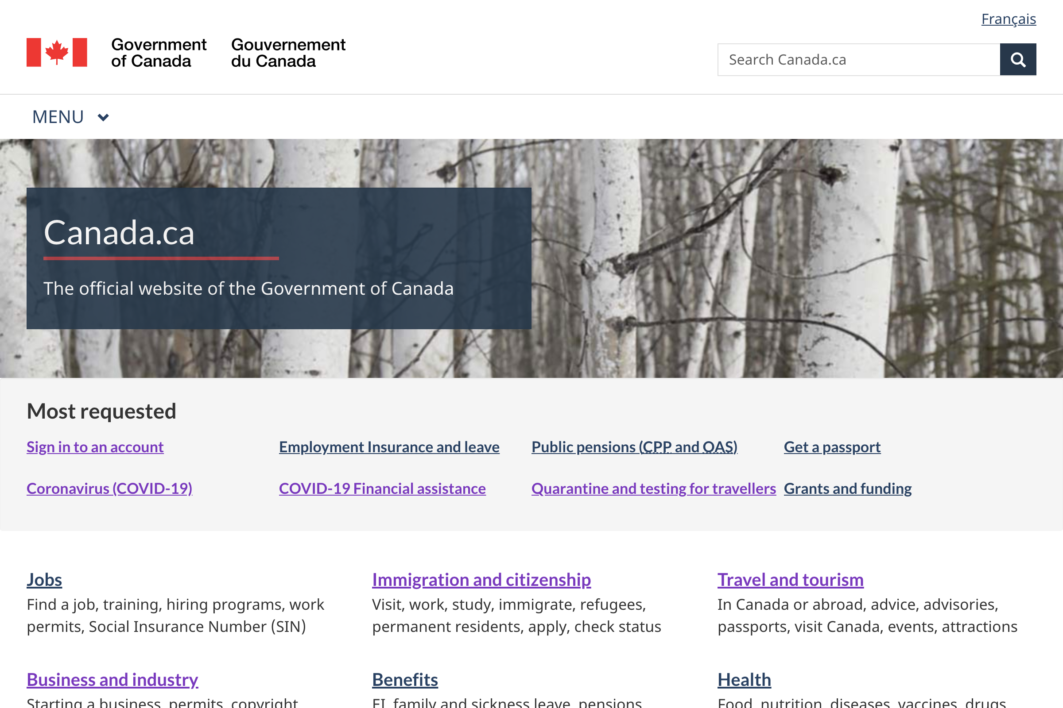
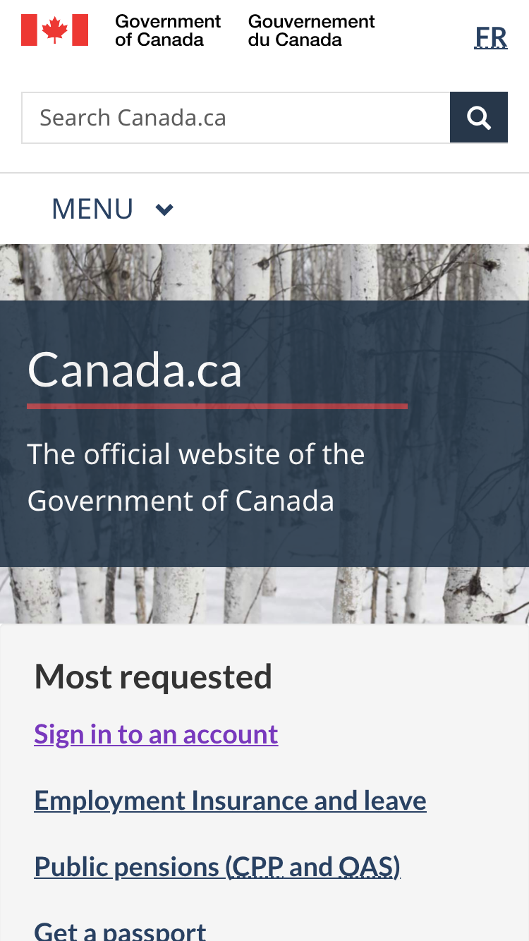

Slide 3
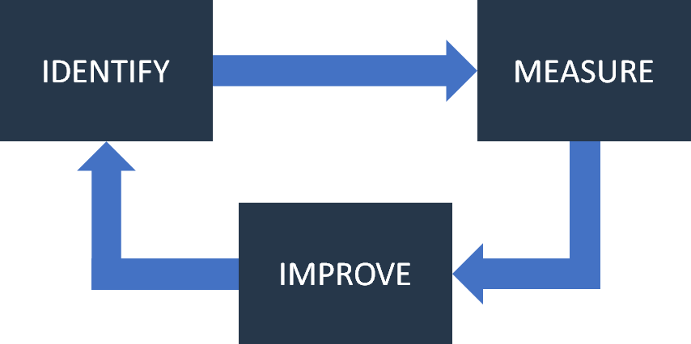
Canada.ca UX strategy: top task management
What are the most important tasks for our users? How can we make it easier to succeed in completing these tasks?
Notes:
Top tasks are the things that people want do do on your website the most. Prioritizing top tasks ensures that we work on what is most important for the people using Canada.ca/GC web presence.

Slide 4
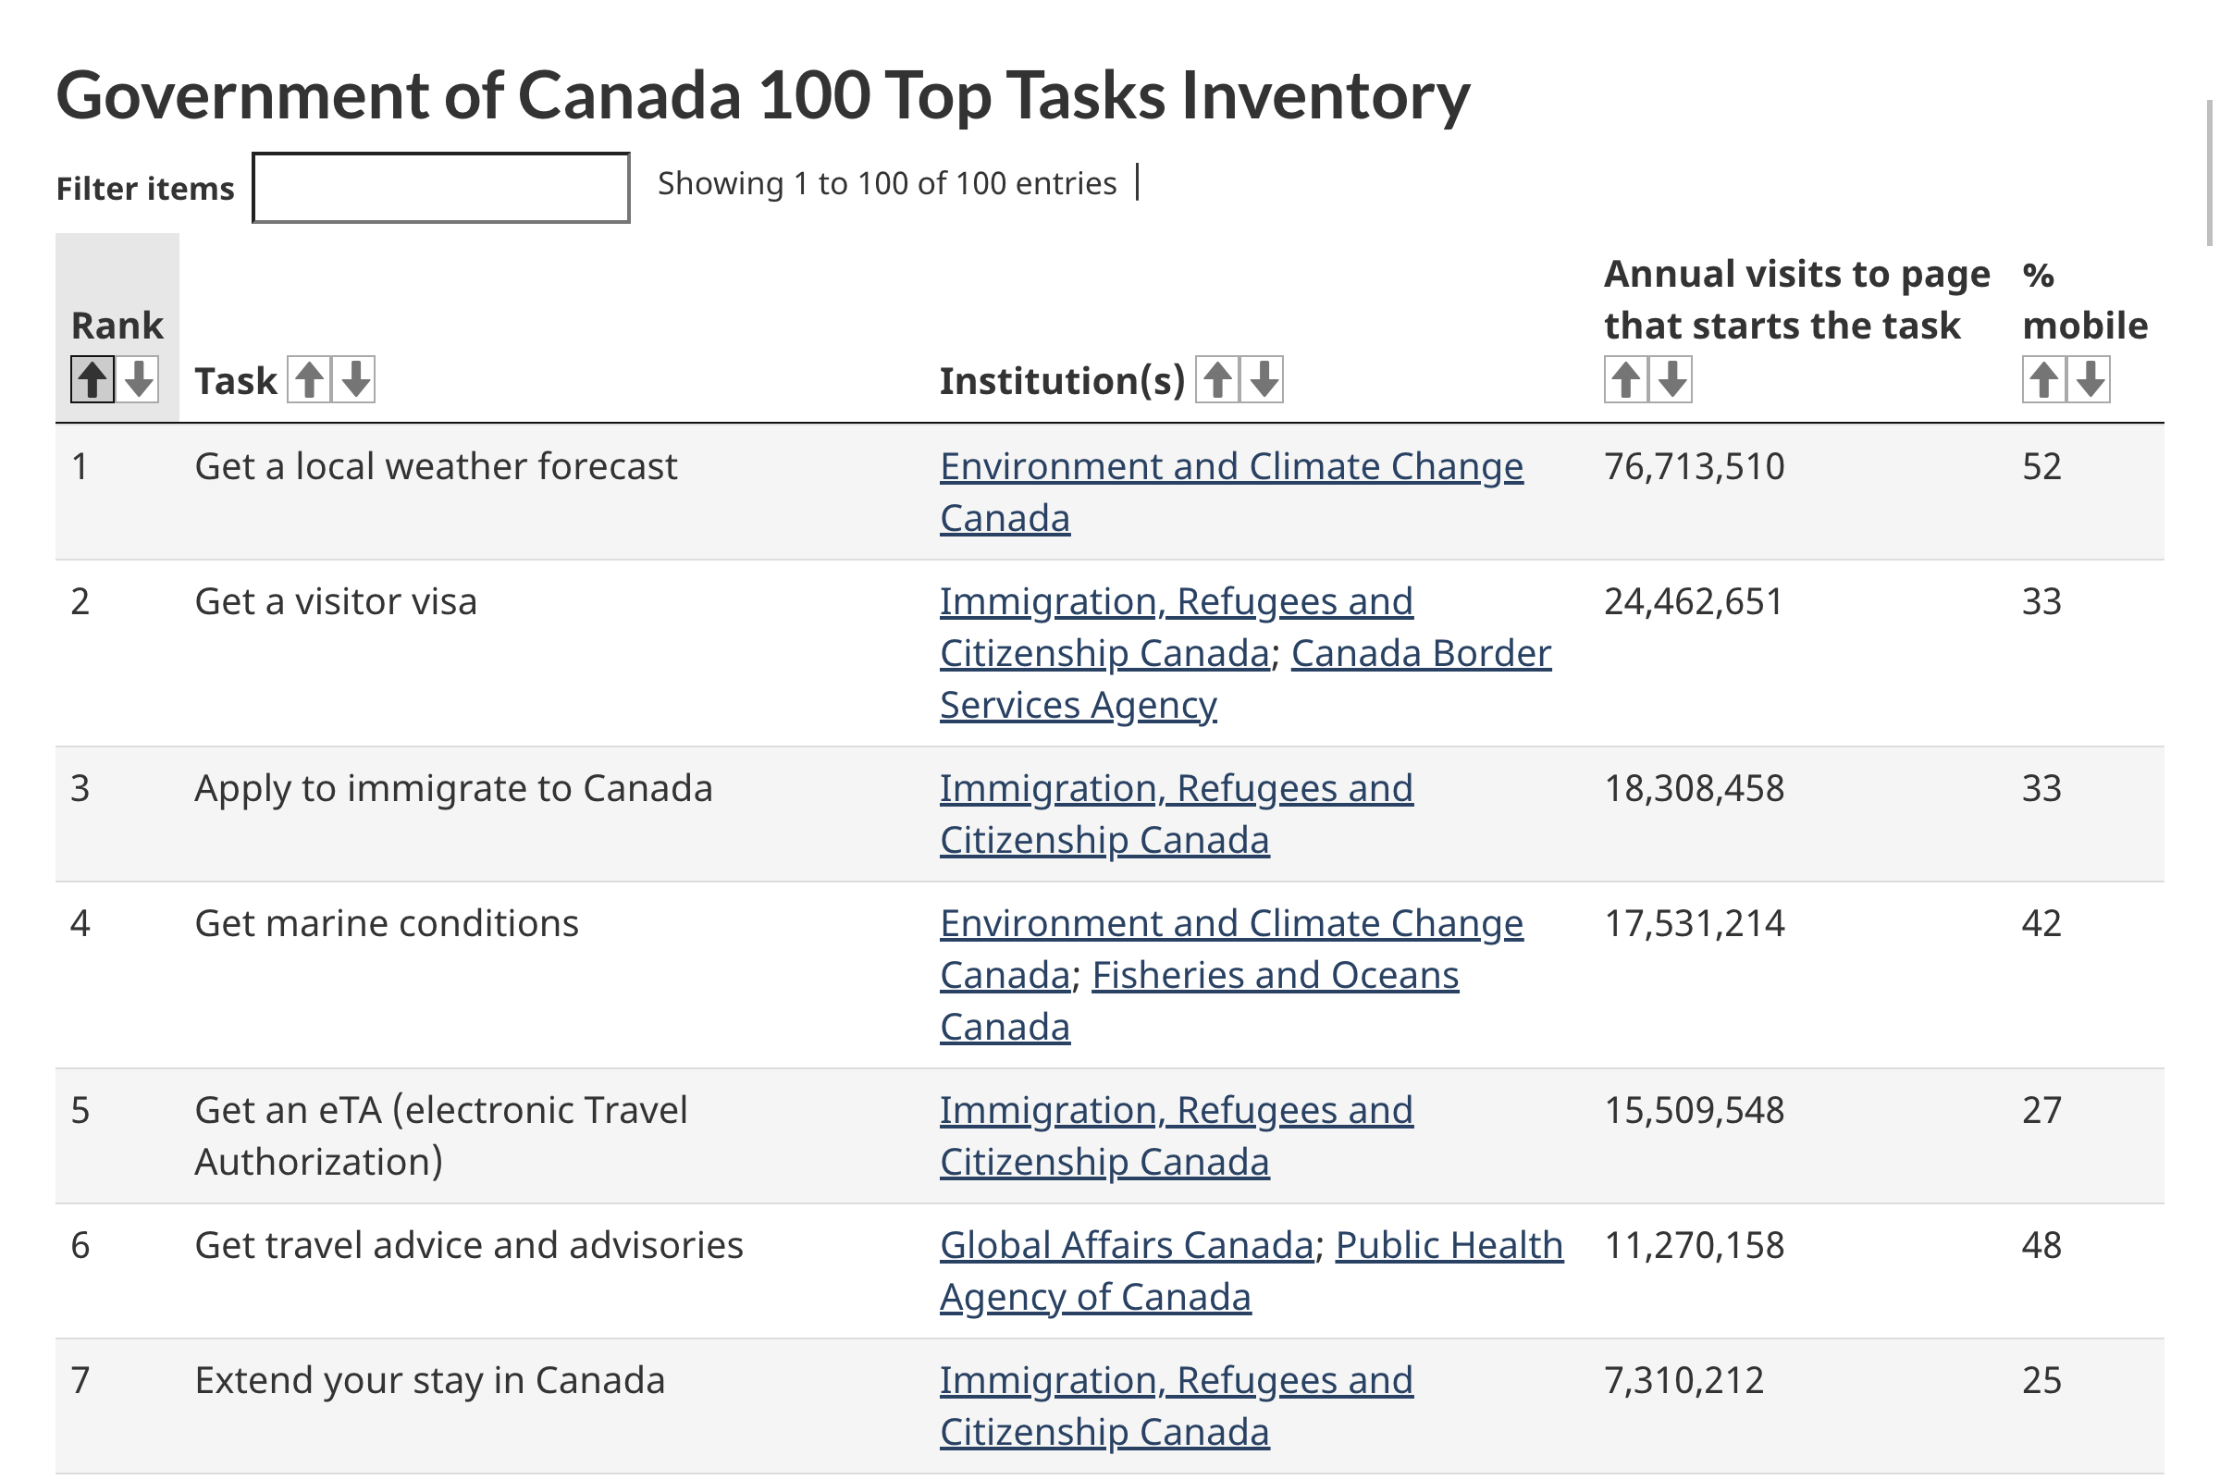
Before COVID: top tasks were stable

Slide 5





Top task optimization: team roles
User researcher
Service lead
SMEs from Departments
Interaction designer
Content designer

Slide 6
Top task optimization process (pre-pandemic)
3-4 months - DTO partners with departments
Initiation
Discovery
Baseline test
Design/ prototypes
Comparison test
Production
1
2
3
4
5
6
Goal: 80% task completion or +20 % pts over baseline

Slide 7
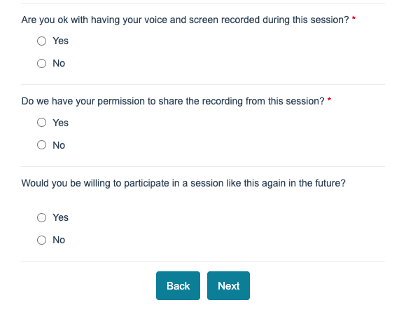
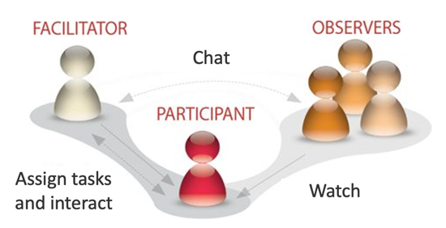
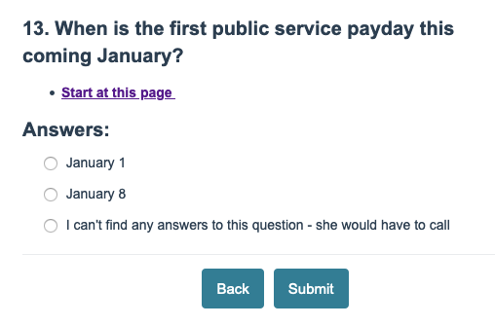
Usability testing in optimization: measuring task performance
Two rounds: baseline and comparison
Minimum 18 participants per round
Notes:
We use survey software in conjunction with screen sharing tools for ensuring rigour in measuring task completion. By asking the participant whether they found the answer or not via an interactive survey question rather than just verbally, we ensure consistency in reporting success or failure from one session to the next. Survey tools are also helpful in terms of getting participant consent to be recorded.

Slide 8
DTO optimization projects 2017-2020
Year | Project | Dept | Baseline Task Success (%) | Prototype Task Success (%) | Change (pts) | Implementation status
2017 | Business start-up activities (pilot) | ISED CRA | 52 | 88 | +36 | Live
2017 | Visit Canada – travel documentation (pilot) | IRCC | 45 | 92 | +47 | Live
2017 | Local Weather | ECCC | 33 | 72 | +39 | Live
2018 | Disease and immunization | HC/GAC | 53 | 84 | +31 | Live
2018 | GST/HST and Payroll | CRA | 48 | 76 | +28 | Live
2018 | EI Caregiver Benefits | ESDC | 52 | 79 | +27 | Live
2018 | Business registration and accounts | CRA | 34 | 72 | +38 | Underway
2018 | Recalls and safety alerts | HC | 52 | 86 | +34 | Underway
2018 | Find a government job | ESDC PSC | 59 | 85 | +26 | Partially live
2018 | Prepare for the citizenship test | IRCC | 69 | 86 | +17 | Underway
2018 | Student loans and grants | ESDC | 61 | 88 | +27 | Live
2018 | EI maternity and parental leave | ESDC | 28 | 78 | +50 | Live
2019 | Contact us Web + voice | CRA | 40 | 85 | +45 | Live
2019 | Travel advice | GAC | 23 | 72 | +49 | Underway
2019 | Canada Child Benefit | CRA | 33 | 84 | +51 | Live
2019 | Electronic procurement | PSPC | 23 | 68 | +45 | In development
2019 | Pay information | PSC, DND, TBS | 18 | 78 | +60 | Underway
2020 | Medical Devices | HC | 16 | 62 | +46 | In development
2020 | Wayfinding | Multiple depts | Project on hold

Slide 9
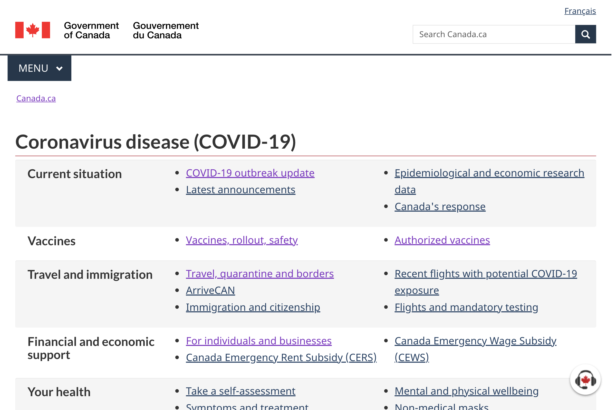

COVID pandemic changed everything

Slide 10
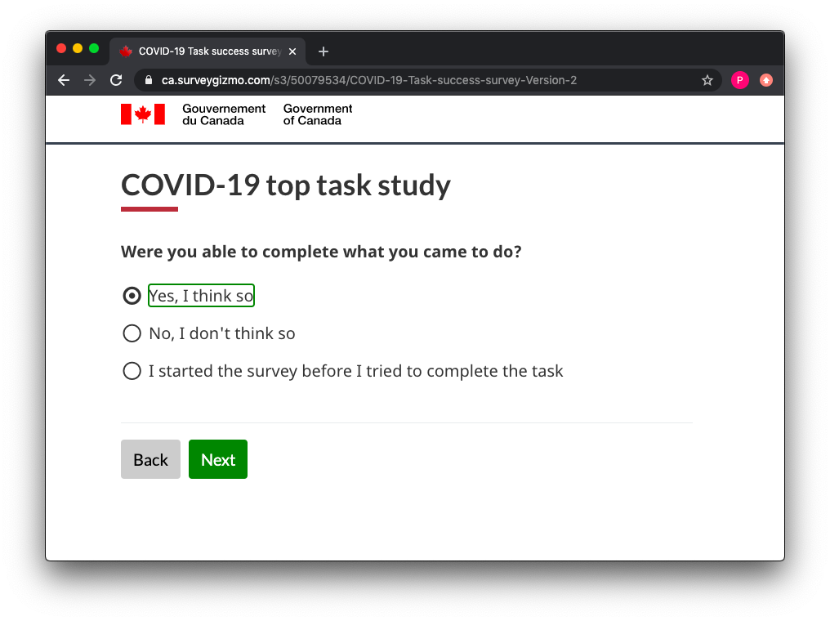
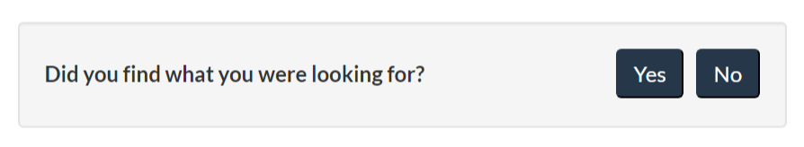
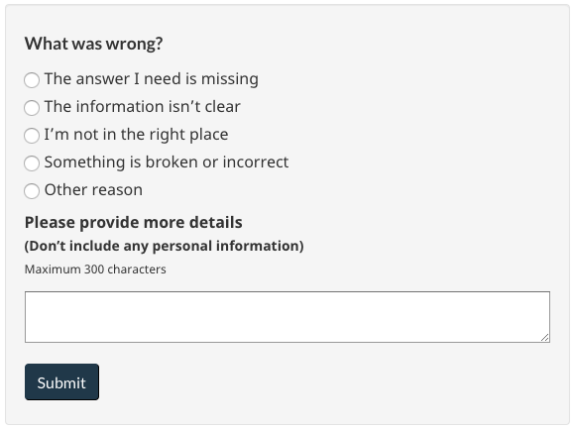
COVID response: rapid research - use incoming data to identify issues
Exit surveys: self reported task success
2. Pilot in-page user feedback: specific issues
Notes:
To support rapid, continuous research and design, we’ve developed two streams of continuous incoming data. - COVID top task survey allows us to understand what the top tasks related to COVID are, and serves as a indicator of where more work may be required to improve task success.
- In-page user feedback is strategically deployed on key COVID pages, and provides intelligence into why task failures may be happening.
We are in the process of rolling out the task survey concept more widely, to cover top tasks across the GC web presence. We are also looking at how to scale the in-page feedback system more broadly as well.

Slide 11


COVID UX response: rapid unmoderated usability testing
Qualitative usability testing
Approximately 5 participants
Online remote sessions, next-day turnaround
Focus on observing behaviour and identifying issues
Notes:
Once an area of further study is identified, online moderated tests are used to get a deeper sense of the issues people are having. They are also used to test whether the prototypes we develop are solving those issues.
Strategy deployed here is to run multiple iterative small studies to confirm design choices, rather than a few large before/after studies.

Slide 12
COVID continuous improvement model
80%+
Improve based on incoming data
Monthly review of self-reported task success data
65%-79%
Improve based on incoming data + unmoderated tests
<65%
In-depth optimization
Alpha: still experimental
Notes:
We are currently experimenting with a continuous improvement model based on incoming data from the COVID top task surveys. Under this model, the level of research and design effort depends on the indicators we see in the survey results.

Slide 13
How did COVID-19 tasks perform in January?
 | December | January | Change from December | Task group
1 | 79.45% | 73.4% | - 6.05 | Cases, statistics, news, outbreak status
2 | 75.89% | 75.0%* | -0.89 | Government of Canada COVID-19 guidelines and strategy
3 | 74.45%* | 59.9%* | -14.5 | Vaccines and prevention (COVID Alert, masks, transmission) (*Moved vaccines into this task group)
4 | 72.76% | 72.5% | -0.26 | Immigration (study, work, visiting, applications, status)
5 | 67.48% | 59.8%* | -7.68 | Symptoms, testing, recovery (*Moved vaccines into prevention task group)
6 | 65.56% | 66.7% | +1.14 | Travel and quarantine (*Survey invite added to more travel-wizard pages at end of January)
7 | 61.04% | 57.7% | -3.34 | Employment Insurance
8 | 59.07% | 60.01% | +0.94 | Financial support (Canada Recovery Benefits, business, other)
*Confidence in this success rate may have a larger margin of error due to <384 responses. 384 responses are required to have a 95% confidence level with a +/- 5% margin of error.
Legend | 80%+ | 65%-79% | Under 65%
Half of the tasks fall into the red task success range this month.
We need to focus more effort on these areas.

Slide 14
Continuous improvement in a rapidly changing environment
New program
New policy
New policy
New program
New policy
New policy
New program
New policy
New program

